Slide 1
Management of Male Infertility
SIG Endocrinology 2019
Chairperson – Madhuri Patil

Slide 2
Abnormalities that can be present in Semen
Volume – Low or High
Viscosity –Hyperviscous
Count – Absent or Low
Motility –Low or Absent
Morphology – High TZI
Agglutination – Antisperm antibody
Infection

Slide 3
Medical Rx
GnRh
Gonadotropins
Surgical RX
Varicocele ligation
Microsurgical repair of vasal obstruction
Assisted Reproduction
Third party Reproduction
Donor Insemination
Adoption
IUI
IVF
ICSI
PESA/TESA ICSI
Anti-estrogen therapy – CC, Tamoxifen
Androgens – Mesterolone
Support sperm capability for fertilization Vitalizers: l-carnitine, CoQ10
Epididymal obstruction
Transurethral resection of the ejaculatory ducts (TURED)

Slide 4
Medical Rx
GnRH
Indicated only in hypothalamic hypogonadism
SC/IV administration with micropumps for several months makes compliance difficult
Gonadotropin therapy
Indicated only in hypothalamic hypogonadism with low FSH & LH levels
Dose: hCG - 2000 IU twice a week FSH – 75 IU thrice a week
Anti-estrogen therapy- CC/Tamoxifen
Block the estrogen receptor preventing inhibition of GT secretion
Most controversial results -some studies report benefit, while others do not
Given for 3 months
CC – 25 mg or Tamoxifen 20 mg for 6 mts Tamoxifen is preffered to CC as it exerts a weaker estrogenic action
Establishment of clear cut guidelines for use necessary
GnRh therapy with use of micropumps
First spermatozoa appear in the ejaculate after a median of 7 months

Slide 5
Medical therapy in treatment of Oligoasthenospermia
Use of Aromatase Inhibitors
High estrogen levels in combination with low T levels impair proper spermatogenesis
Elevated levels of E2 lead to feedback inhibition of the HPG axis, thus decrease LH, which is necessary for the production T, and FSH to optimize sperm production
Anastrozole 1 mg daily, or letrozole 2.5 mg daily) increase T, decrease estrogen levels, and inhibit the peripheral metabolism of T
Effective in restoring LH, FSH, and T levels, improving semen parameters, and re-establishing fertility

Slide 6
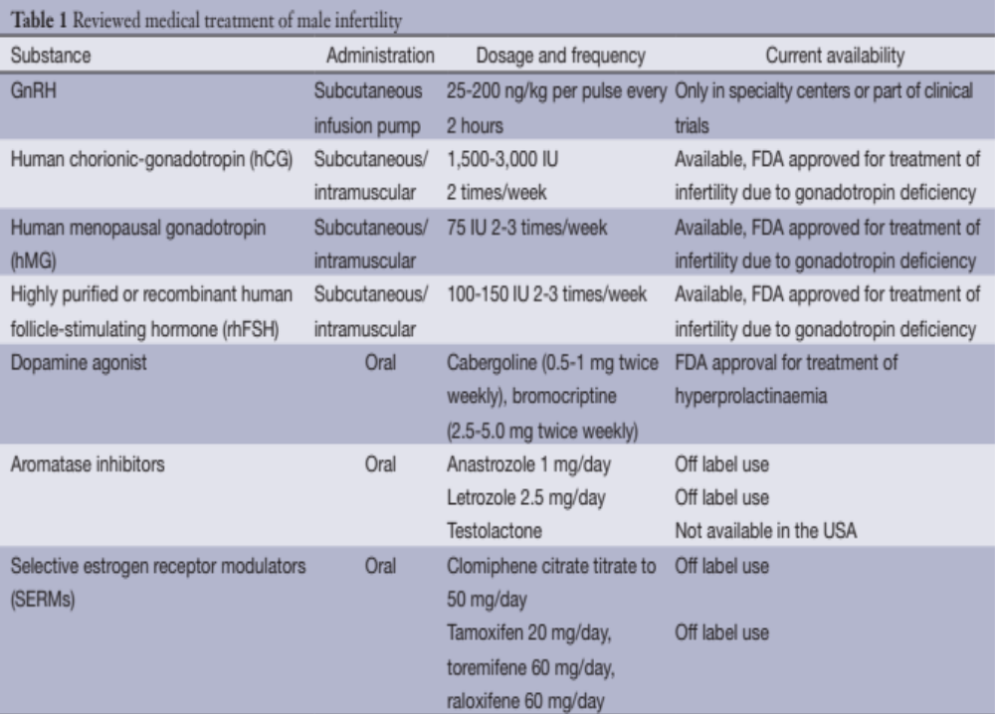
✔/?
✔
✔
✔
?
?
Ali A. Dabaja, Peter N. Schlegel ; Transl Androl Urol 2014;3(1):9-16

Slide 7
Medical Rx
Androgens
Mesterolone: Suppress tubular testicular function - temporary oligo or azoozpermia allowing function to rebound after
Testosterone undecanoate : To promote androgen bioactivity in epididymis and in accessory glands
Food and Vitamin supplementation
Carnitine, zinc, folic acid, astaxanthin, Vit C, Vit E, COQ may improve male infertility
Direct effect on sertoli cells & epididymal function and improve spermatogenesis
Other endocrinopathies and systemic diseases
Thyroid, Adrenal, Hypothalamis and pituitary
Diabetes, HT, Renal disease and malignancy
treatment is stopped. No benefit reported
Amplification in bioavailability of DHT in peripheral blood
Antibiotics for genital tract infection
Involved in cellular respiration, improving motility and preventing oxidative stress

Slide 8
Sperm concentration, viability, motility, acrosome reaction rate is increased
Percentage of abnormal spermatozoa is decreased
Oocyte fertilization is improved
Generation of ROS is suppressed
Intracellular content of cAMP and cGMP is increased
Proportion of PUFA in phospholipids and sperm membranes is reduced
Sperm DNA fragmentation is reduced
PR is improved (very few studies)
Advantage of Antioxidants

Slide 9
Potential harm of Antioxidants
Wrong (high) doses might have opposite effects
Selenium and vitamin E cancer prevention trial (SELECT) indicated that for certain populations, supplement increased prostate cancer risk & severity
Beta-carotene is strongly contraindicated in smokers as it has a increased risk of lung cancer
Long term intake of 20 mg Vitamin B6 may lead to mild tingling and numbness
Long term intake of 5mg of manganese may lead to muscle pain and fatigue
Long term intake of 30 mg zinc may lead to anaemia
High doses of vitamin C may cause kidney stone formation

Slide 10
Antibiotics for semen infection
Varicocelectomy
Vitamin (Antioxidant) supplementation
Vitamins C, E
Selenium
Folate
Zinc
Minimize exposure to gonadotoxins hyperthermia
Eg – smoking, medication, saunas, hot tubs
Treatment Options
for Increased DFI
ICSI with testicular sperm
CPR 44 % ( 8/18) in patients
with > 15 % sperm DNA damage

Slide 11
Surgical therapy
Varicocele Ligation
Efficacy of varicocelectomy as a Rx controversial but beneficial in severe and symptomatic cases
Obstructive azoospermia
Microsurgical repair of vasal and epididymal obstruction
Low volume ejaculate and severe oligozoospermia Transurethral resection of the ejaculatory ducts (TURED

Slide 12
Selection of treatment modality
Semen parameters
Concentration
Progressive motility (TMC)
Depends on the etiology of infertility
Morphology and TZI
HOS and DFI

Slide 13
Selection of treatment modality for male sub-fertility depends on
Parameter | IUI | IVF | ICSI
Concentration | >10 million/ml | 1-10 million/ml | < 1 million/ml
Total motile count | > 5 million/ml | 1–5 million/ml | < 1 million/ml
24 hours sperm survival | > 70 % | < 70 % | < 70 %
TZI | < 1.6 | 1.6 -1.84 | >1.84
HOS | > 60 % | 50 - 60 % | < 50 %
DFI | <15 % | 15 – 30 % | >30 % >60 % TESA/ICSI

Slide 14
Other Factors
Age of the women - above 40 years should receive GT for OI & should consider IVF early in the treatment protocol
Duration of sub fertility
Presence or absence of cervical factor
Presence of endometriosis or tubal pathology
Presence of anti-sperm antibody - male or female
History of previous pelvic or abdominal surgeries

Slide 15
IUI vs IVF vs ICSI
There is no perfect answer for non-male factor or Mild to moderate male factor infertility
A good compromise seems to be
IUI for 4 cycles
If no pregnancy proceed with ART
If few good eggs-do ICSI
If no pregnancy proceed with ART
If many eggs-do IVF + ICSI

Slide 16
Azoospermia
History; Physical examination
Semen Analysis
Hormones – FSH, LH, Testosterone
Testicular USG
Testicular Volume Normal
FSH, LH and Testosterone Normal
Testicular Volume Normal/
Testicular Volume
FSH, LH Testosterone – /Normal
Ej. Vol -
Altered pH
Ej. Vol - N
pH - N
FSH
LH, T - N
LH T – /N
FSH – N/
Pituitary Imaging
Hormonal Analysis for HH
Urine for sperms
FNAC
FNAC
-ve
+ve
Normal
Pathologic
TRUS
FNAC
SPZ +
SPZ -
AR
Mutation
Functional HH
Organic HH
Deeper Analysis
Primary Testicular failure
Retrograde Ejaculation
Suggestive of Obstruction/Absence
Congenital or Acquired
Microadenoma
Empty Sells Syndrome
Karyotype
‘Y’ microdeletion
Genetic Analysis
CFTR

Slide 17
Take Home Message
End-point of the infertile male evaluation is to find, if possible, a patho-physiologic specific treatment to :
Achieve spontaneous pregnancy and reduce the need for ART
Downgrade the level of ART needed
Increase the pregnancy rates when ART is unavoidable

Slide 18
Spermatogenesis cannot be readily altered for therapeutic benefit
Sperm function test may be useful for identifying a male factor contributing to unexplained infertility or for selecting therapy
Test done include, Trial; wash with sperm survival, HOS and DFI
Effective treatment of male infertility is remote possibility as pathogenesis remains obscure & one has to resort to treatment at gamete level - ART
Take Home Message

